Slide 1

USER-ROLE AUTHORIZATION FOR DATA SECURITY
INFORMATION ENCODING STANDARDS

Slide 2

INTRODUCTION
This Project demonstrates how data security is achieved by providing user-role based authorization and the authentication in the software systems

Slide 3

Meet the Team
GROUP -3
Mahinthan Kugendiran
Digvijay singh
Syed Numan Ahmed

Slide 4
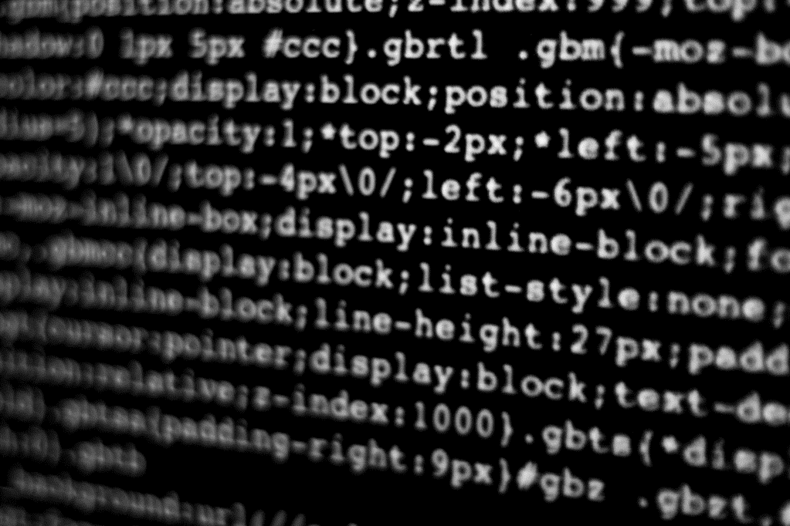
Demonstration
Part-1

Slide 5
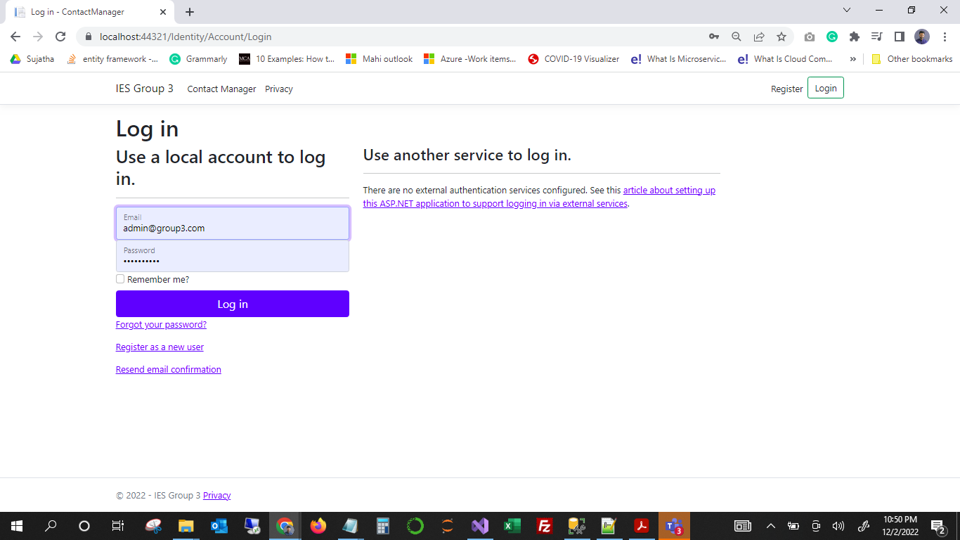
LOGIN PAGE

Slide 6
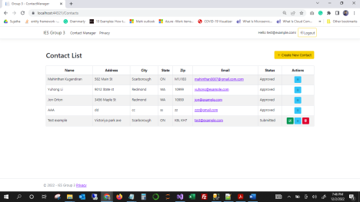
Registered users

Slide 7
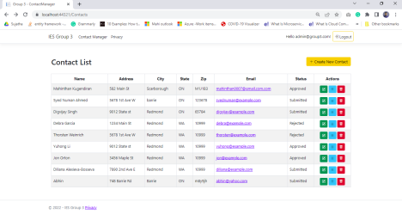
Administrators

Slide 8
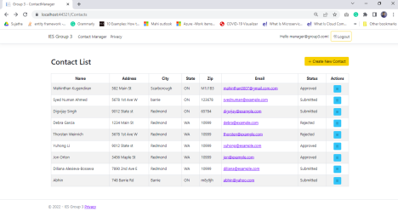
Managers

Slide 9
Part-2
Client Questions

Slide 10
How can we transfer personal data securely within their network?
Using data encryption methods can help protect information while in transit. For example:
SSH (Secure Shell)
The SSH (Secure Shell) collection of programs and protocols provides a highly configurable way to transfer data safely and even encrypt data streams from other programs that are otherwise not secure.
 | Q2 | Q3 | Q4

Slide 11
What security protocol is best for transferring personal files?
SFTP-SSH File Transfer Protocol
-Developed by Internet Engineering Task Force[IETF]
-Commonly used to transfer sensitive data such as personal information.
-Built on Secure Shell Cryptography.
-Information is transferred in form of Packets.

Slide 12
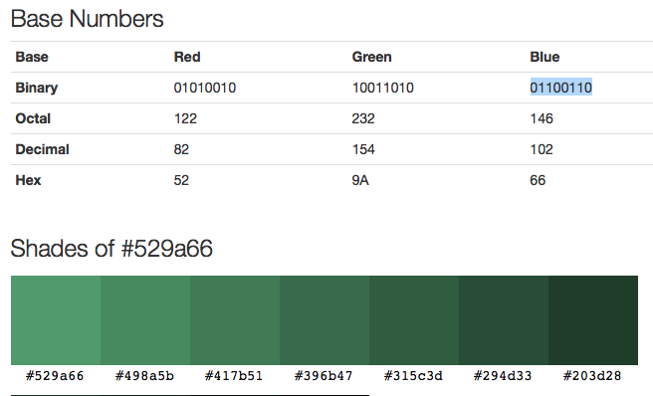
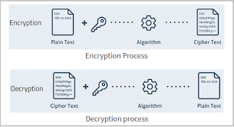
Can we Encode and Encrypt images?
Yes an image can be encoded and encrypted.
Encoding:
 | Q2 | Q3 | Q4
Encryption:

Slide 13
Our database cannot be moved from the site and we need to be able to access it externally using a secure API. Can you explain the architecture of a secure API?
API Gateway An API Gateway is a necessary component of an API security architecture because it works as a focused server that controls traffic. This capability can also detect possible attacks that will leave your APIs open and at risk.
There are many ways to secure an API security architecture, but here are a few ways to put this in place via a trusted API Gateway:
Control Connections to the API Gateway should be consistent and very persistent so that possible encryption cannot be recognized.
Inaugurate sorting procedures and alarms The API Gateway should be made to filter out requests. This should also include the ability to block out threats. Further, notification should go out when danger is imminent.
Harness protective layers The API Gateway should be able to provide a high-end buffering layer. This helps to protect the API from danger.
Deploying a possible cyberattack With an API Gateway in place, your API security architecture can indicate when an attack is about to happen. This is a win-win for all.
Management An API Gateway should be able to manage action for authorization. This allows for an API security architecture to have access.
Safety An API Gateway is necessary to block attacks—bar none. When an unguarded API is in danger, this is a complete call for all API security architecture to be in place.
 | Q2 | Q3 | Q4

Slide 14
Can you recommend a secure framework for coding an API?
REST API- Representational State Transfer is a secured Framework that can be used to code an API
-It uses HTTP and supports Transport Layer Security encryption
-Uses JSON which also makes it easier to transfer data
 | Q2 | Q3 | Q4

Slide 15
What data interchange format should we use while transferring data between locations?
JSON: JavaScript Object Notation
-JSON is a text-based data format following JavaScript object syntax.
-Commonly used to transmit data between clients and servers.
-Readily processed by most Programming Languages.
 | Q2 | Q3 | Q4

Slide 16
How should we store our data in our many locations?
1. Enable full disk encryption on all devices
2. Restrict confidential data to the office
3. Don’t transfer unencrypted data over the Internet
4. Delete sensitive data you no longer need
5. Encrypt backups
6. Store more than one copy
7. Secure archive and crypto container passwords
 | Q2 | Q3 | Q4

Slide 17
What are the ethical concerns related to the transmission of personal data?
Ethical Concerns related to the Transmission of Personal Data:
Freedom from unauthorized access to private data
Inappropriate use of data
Accuracy and completeness when collecting data about a person or persons (corporations included) by technology
Availability of data content, and the data subject’s legal right to access; ownership
The rights to inspect, update or correct these data
 | Q2 | Q3 | Q4

Slide 18
THANK YOU

